Slide 1
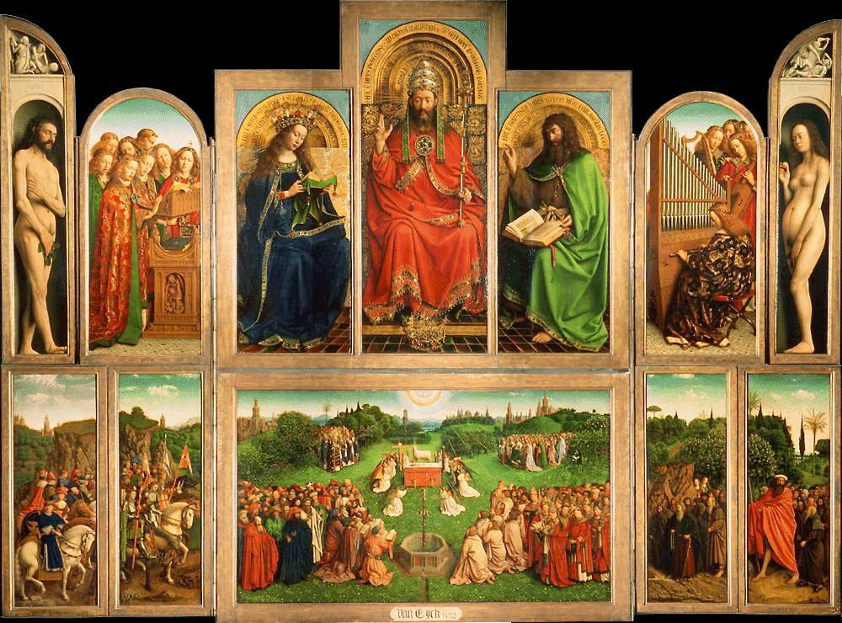
Northern Renaissance
Katherine Kim
Period 5

Slide 2
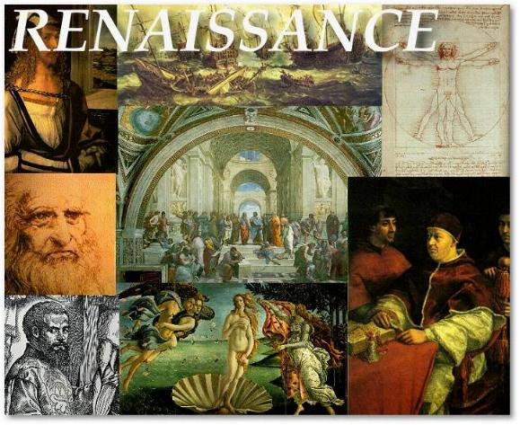
What was the Renaissance? How was it spread?
During the 14th- 17th century a new way of thinking was introduced, taking over the ideas and views of the Middle Ages.
Helped Europe reach economic growth
Renaissance ideas spread into the North by war, newly educated students returning home, and culturally by trade
Look for links to click!
More on the Renaissance

Slide 3
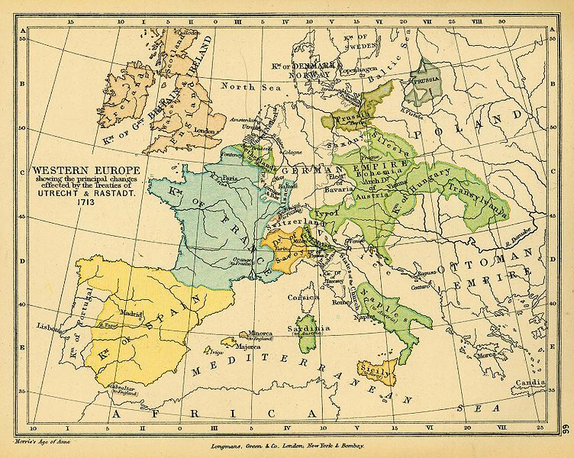
Major Cities
Bruges, Tournai, and Ghent- were all centers of international commerce.
  Acted as central locations for exchange of ideas
Bruges rivaled Florence
  Wealth from wool trade and international banking.
See larger map

Slide 4

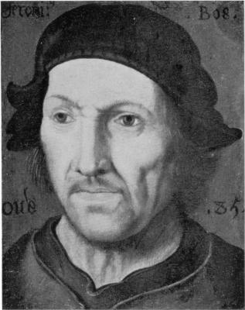
Patrons
Artists mostly employed by secular courts of dukes especially the dukes of Berry, Bourbon and Nemours
Patrons of the arts were essential to the growth of the movement as well as the economic growth at the time
They invested/supported artists by paying them to produce their works of art.
Some of their work (Scroll down)
Who is this?

Slide 5
Humanism
More focused on writings of early Church fathers and Church reform
Turned to classics for ethical reference
Practice was modified so that one could do it on their own time and in their personal convenience
The changes to Humanism during this time made humanism more personalized
More on Humanism

Slide 6
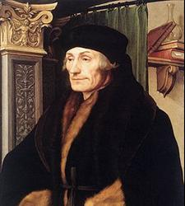
Desiderius Erasmus
Dutch humanist
Writer who struggled between classics and religion.
Emphasized common ethical sides of each
Demonstrated in The Handbook of the Christian Knight that restoration of Christianity to it’s condition at the time of Christ should be the aim of religion.
Believed the “philosophy of Christ” should be the guide for every day life.
Erasmus

Slide 7
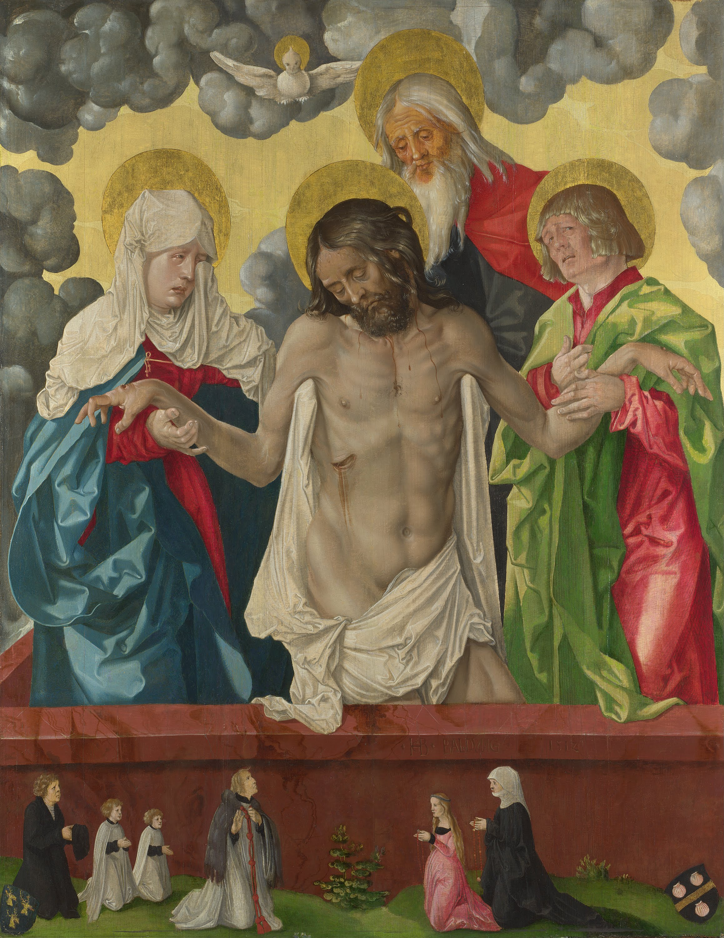
Mystics
Many factors leading to ultimate goal
  Type of life one lived
  Living as close to godlike as possible
  Proper state of mind when communicating with God (Northern Renaissance Humanism).
Stressed practicality and inner piety
  Simpler, not as formal (Northern Renaissance Humanism).

Slide 8
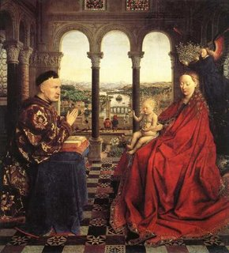
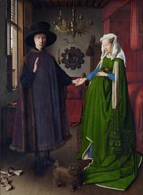
Themes of art
Flemish painters- first to test with three-dimensional illustration (Wright 50).
Full-face and three-quarter profile views were mastered
“Organ” from “The Ghent Altarpiece”
More on Flemish paintings

Slide 9

Architecture
Links- enlarged picture/more information
Château de Chambord under Francis I
The Escorial in Spain
Cathedral, palace, and monastery all in one and unified by classical architecture
Juan Bautista de Toledo
was the first architect to work on the Escorial.
designed the ground plan on a gridiron scheme
Juan de Herrera
Second architect to work on it after Toledo’s death.
Finished product = uniquely Spanish

Slide 10
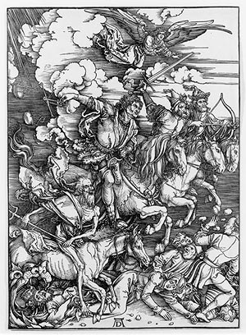
Albrecht Dürer
Attempted to blend Northern and Italian styles
Traveled to Venice to view the Renaissance there
Most famous for his engravings
Emphasized detailed representation of nature and religious purposes that were part of Northern art characteristics (Chambers 355)
What piece of art is this? And more on Dürer

Slide 11
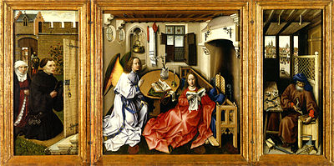
Robert Campin
Flemish artist
First to go from egg-based to oil-pigments (Wright 50).
Became important by eventually receiving commissions from his local city government
Ran a workshop eventually employing talented young artists
Curious about the background?

Slide 12
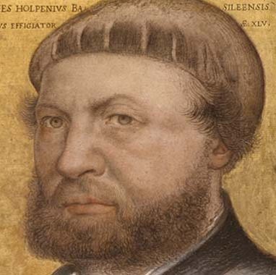
Hans Holbein the Younger
German painter
Portrait painter in London; in high demand
Combined his art with phycology
Very careful attention to detail
Use of color
Paved way for school of English miniaturists
For More On Me!

Slide 13
Works of Hans Holbein the Younger
The Ambassadors
Portrait of Margaret Wyatt
Noli me Tangere

Slide 14

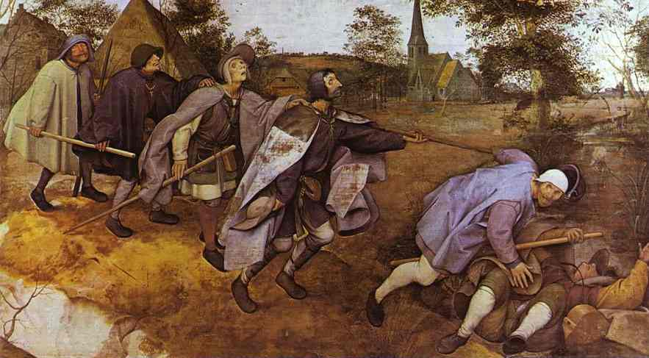
Pieter Bruegel the Elder
Flemish artist/satirist
Painted what he saw as the “true condition of man” under nature’s unpredictable forces(big book)
Paintings known for expression
Represented peasant class very often because they were most affected by seasonal alterations
“Parable of the Blind Leading the Blind”

Slide 15

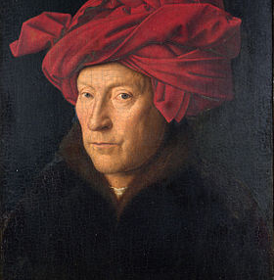
Jan Van Eyck
Contemporary of Donatello, not as focused on idealization and more on the physical world
His art has spacial depth
Depicts landscapes through atmospheric perspective (Wright 51).
Good use of shadows
Used oil-based pigment
More on Eyck

Slide 16
Hieronymus Bosch and Matthias Grünewald
Bosch
  “Garden of Earthly Delights”
  Nude figures in panoramic landscape
  Mixed medieval grotesques with Flemish proverbs
Grünewald
  Perhaps influenced by Bosch’s distortion of natural shapes to convey heavenly or devilish character
  Court painter, architect and engineer for Bishop of Mainz
  “The Resurrection of the Isenheim Alter”

Slide 17

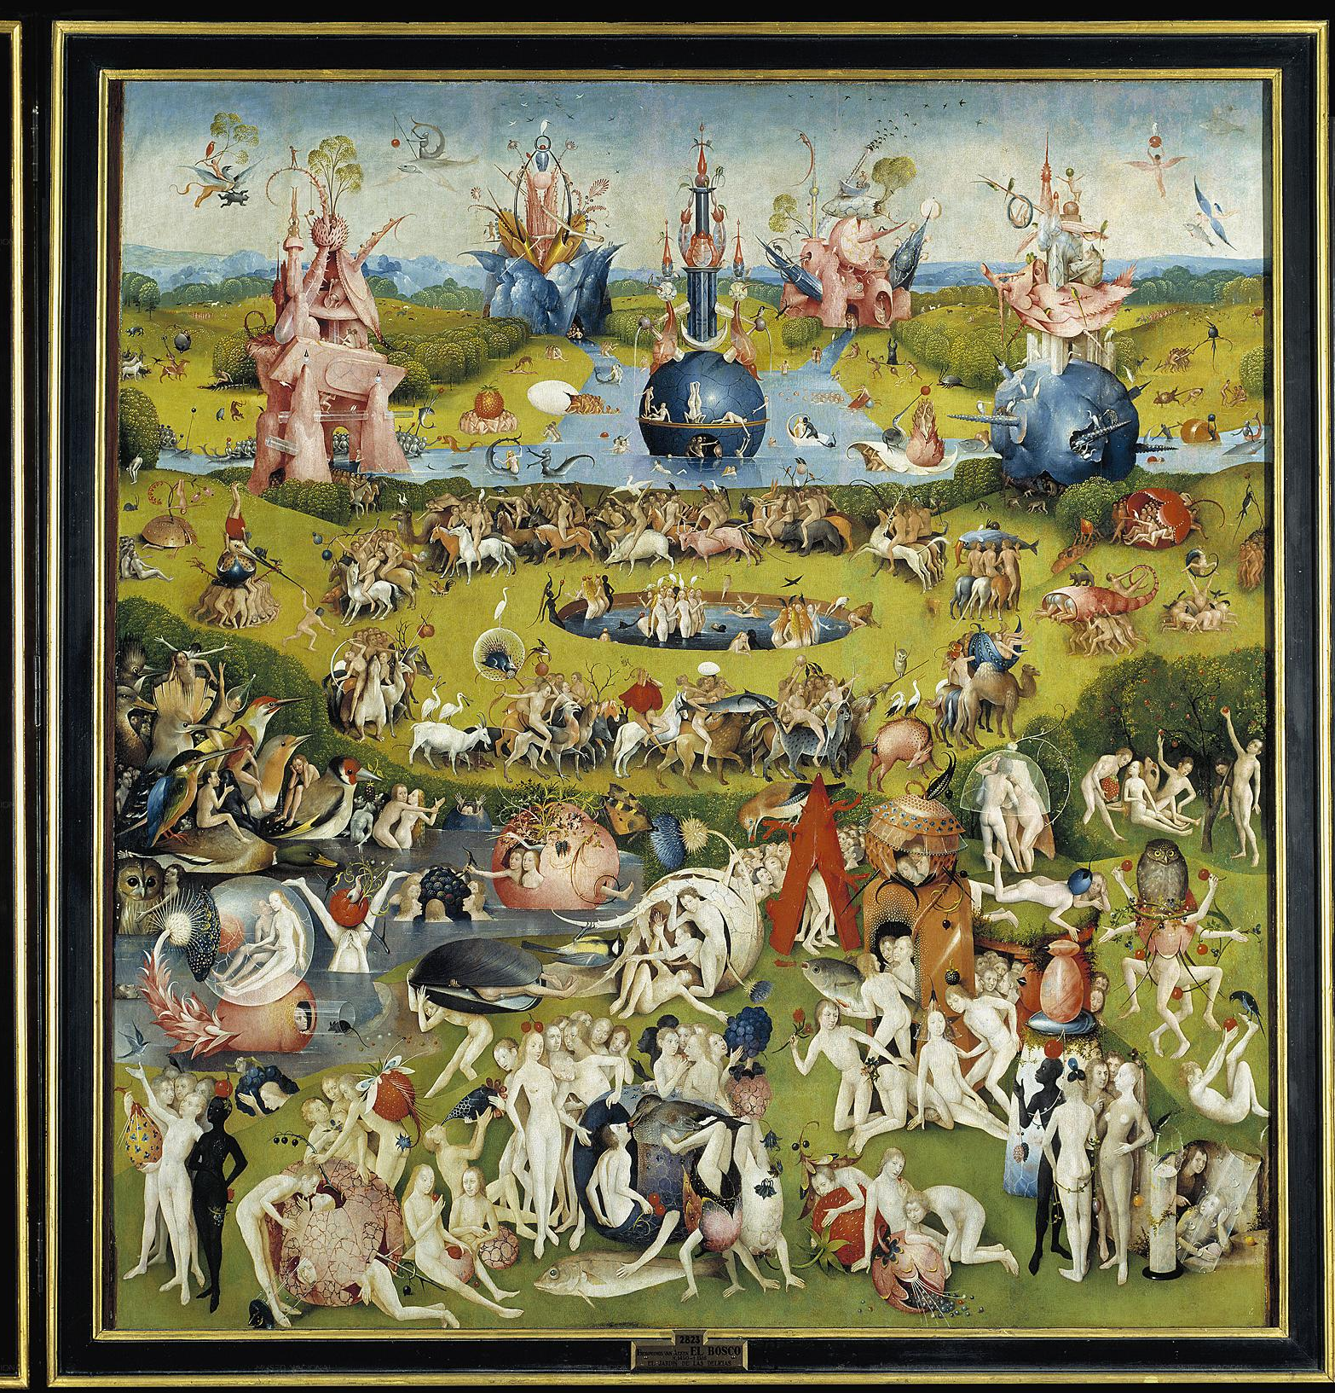
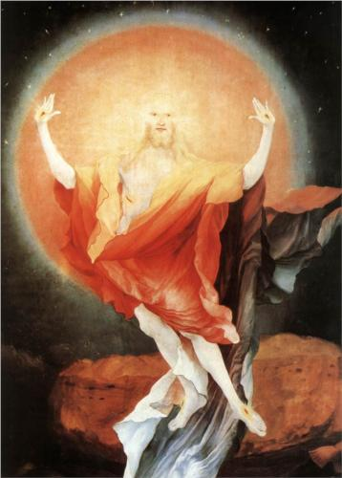
Back To Previous Slide?
“The Garden of Earthly Delights”
“The Resurrection of the Isenheim Alter”

Slide 18
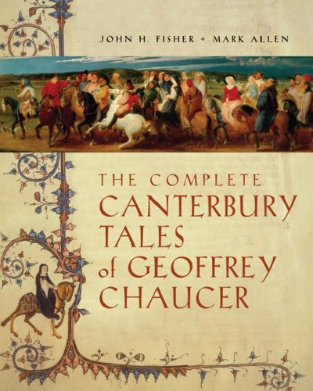
Geoffrey Chaucer- Literature
  Disciple of Boccaccio
  Soldier, diplomat, and government official (Chambers 354).
  Wrote Canterbury Tales
    Accounts pilgrimage to the tomb of St. Thomas Becket in Canterbury
    Stories told by travelers for entertainment and each had a moral
    Master portrayal of Human behavior and personality

Slide 19
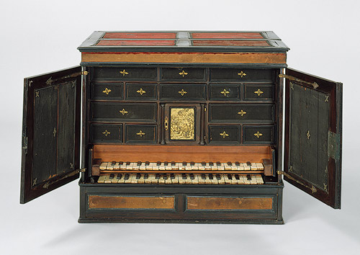
Music
More and more popular in princely courts
Singers and organists in church
Musical notation became standardized (Chambers 355).
St. Cecilia was patron saint
Low Countries were musical center
  Vocal harmonies without instruments made it popular amongst the poorer sort.
More on music and what that ‘thing’ in the background is

Slide 20
How it differed from the Italian Renaissance
Differed in audience and concerns
Focused more on the physical world vs. idealization
Less urban in the North with a nation state political structure vs. Italian more urbanized city-states
Differed in aspects of religious views (Humanism and Mysticism)
More on how they differ

Slide 21

Observing Art
There are many different ways to go about looking at art
  This video will help you recognize some ongoing iconography in various pieces of art
Click

Slide 22

Do you recall?
What/who is a patron and what are their responsibilities?
Key differences between the Italian Renaissance and the Northern Renaissance?
Key figures of this time period
Key ideas of the time period

Slide 23
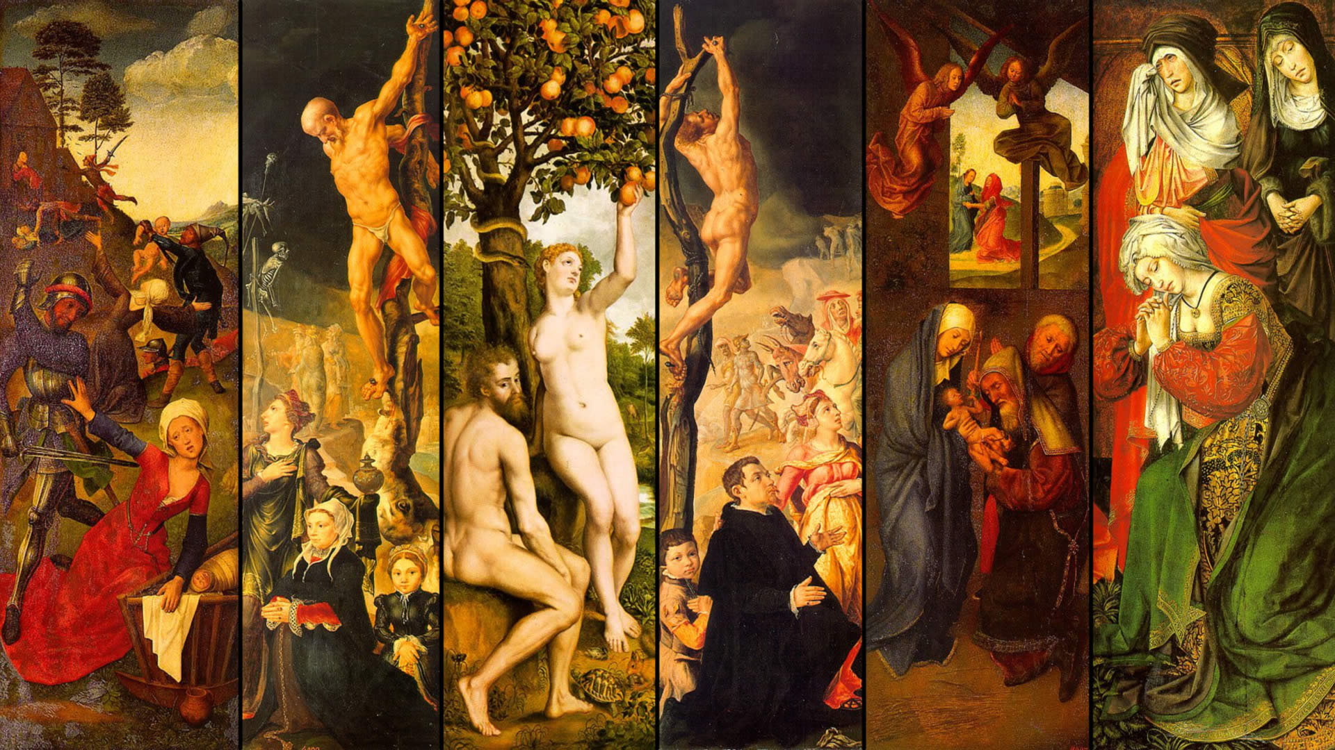
The End!

